Slide 1
Trillingen / Schade
Wat is de kans op schade in structurele akoestiek …..
© 2015 dr. ing. Han Geurdes
Notes:
..... de bebouwde omgeving staat in toenemende mate onder invloed van externe verstorende invloeden. Seismische verstoringen, klimaat veranderingen maar ook zwaardere belasting door toename in vervoer kunnen schade geven via random verstoringen.

Slide 2
Inleiding
Veranderingen in een systeem
  verstorende trillingen
  chaotisch,
  mogelijk gevaarlijk / schadelijk
  Bruggen
  Opslagtanks
  Reactorvaten
  Gebouwen
  …..
  Vleugels van vliegtuigen
  Scheepswand
  ..
RDS = random dynamic systems

Slide 3
Conceptual
Two “vibrating beam” equations as a model for deformation // (in plane) horizontal line:
Fiber optic
S
Beam x1
Beam x2
Notes:
De connectie tussen klassieke structurele mechanica en random dynamische statistiek in een RDE.

Slide 4
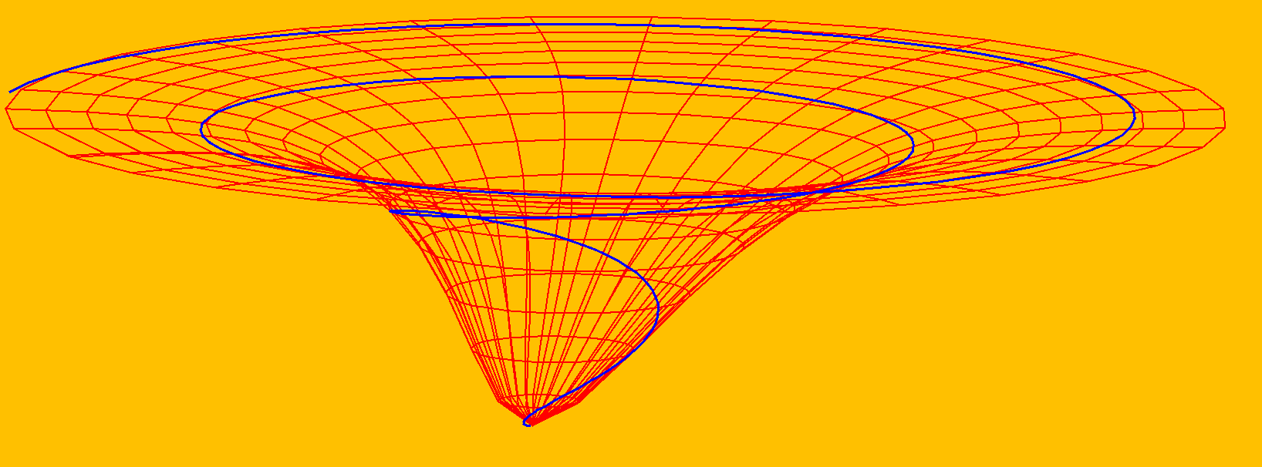
Definition of (weak) attractor:
Attractor set
‘Near’ repeller set
X2
Repeller set
(Stable state)
X1
Near attractor set
S1
S2

Slide 5
Random differential equation (basic to RDS):
In search of the random systems transformation function.
Probabilities in development of the system (weak attractor Arch Math 78, 2002,329-336).
Requirement: phi is a “cocycle”.

Slide 6
A (crude) co-cycle in the data (necessity for the existence of the attractor set).
Firstly, perform a “multiplicative” transformation in iterations, to reach
Secondly, search (iterative ) for average value of U, “close to” unity

Slide 7
A co-cycle in the data & prediction of future states.
past
past
future state
past

Slide 8
Random differential equation.

Slide 9
Numerical integration (examples based on spline functions)
as.function(fT<-splinefun(M3axT[iInit:iFin],M3axT[iInit:iFin]-M3axT[iInit],method=c("fmm"),ties=mean))
YfX<-YRX[iInit:iFin]*exp(-aCoeff[1]*fT(M3axT[iInit:iFin]))
as.function(fX<-splinefun(M3axT[iInit:iFin],YfX,method=c("fmm"),ties=mean))
YfY<-YRY[iInit:iFin]*exp(-aCoeff[1]*fT(M3axT[iInit:iFin]))
…
IntfX<-integrate(fX,M3axT[iInit],M3axT[tijd])
IntegX<-as.double(substr(IntfX,1,11)[1])
…
idx<-1
Ytest<-dYdt[iInit:iFin]
Xtest<-YRZ[iInit:iFin]
rT<-linest(idx)
aCoeff[idx]<-rT[1]
bCoeff[idx]<-rT[2]

Slide 10
Small, but interesting, detour:
as.function(fZ<-splinefun(M3axT[iInit:iFin],YRZ[iInit:iFin],method=c("fmm"),ties=mean))
YfX<-YRX[iInit:iFin]*exp(-aCoeff[1]*fZ(M3axT[iInit:iFin]))…… etc
is used in the case of the (weak) nonlinear heuristic RDE:
We assume
IntfX<-integrate(fX,M3axT[iInit],M3axT[tijd])
IntegX<-as.double(substr(IntfX,1,11)[1])
…

Slide 11
Meetopstelling 16-6-2015 ….. 25-6-2015.
R== deformatie meting
T==temperatuur meting
X,Y,Z triaxial vibration.
Triaxial vibration

Slide 12
Triaxial vibration

Slide 13
Trillingen [m/s²], deformatie [mm], temperatuur [Celcius], 16-6-2015.
time | x m/s2 | y m/s2 | z m/s2 | R1 (mm) | R2 (mm) | R3 (mm) | R4 (mm) | R5 (mm) | T 1(Celc) | T 2(Celc) | T 3(Celc) | T 4(Celc) | T 5(Celc)
12:04:00 |  |  |  | 0.095 | -0.076 | 0.093 | 0.048 | 0.122 | 13.4 | 14 | 12.6 | 13 | 13.3
12:04:10 |  |  |  | 0.095 | -0.076 | 0.093 | 0.048 | 0.122 | 13.4 | 14 | 12.6 | 13 | 13.3
12:04:20 |  |  |  | 0.095 | -0.076 | 0.093 | 0.048 | 0.122 | 13.4 | 14 | 12.6 | 13 | 13.3
12:04:30 | 0.008 | 0.037 | 0.026 | 0.095 | -0.076 | 0.093 | 0.048 | 0.122 | 13.4 | 14 | 12.6 | 13 | 13.3
12:04:40 |  |  |  | 0.095 | -0.076 | 0.093 | 0.048 | 0.122 | 13.4 | 14 | 12.6 | 13 | 13.3
12:04:50 |  |  |  | 0.095 | -0.076 | 0.093 | 0.048 | 0.122 | 13.4 | 14 | 12.6 | 13 | 13.3
12:05:00
12:05:10 | 0.014 | 0.04 | 0.036
12:05:20
12:05:30
12:05:40
12:05:50
12:06:00
12:06:10
12:06:20
12:06:30
12:06:40 | 0.013 | 0.029 | 0.023
12:06:50
12:07:00 |  |  |  | 0.1 | -0.074 | 0.091 | 0.052 | 0.122 | 13.4 | 14 | 12.6 | 13 | 13.3
12:07:10 |  |  |  | 0.1 | -0.074 | 0.091 | 0.052 | 0.122 | 13.4 | 14 | 12.6 | 13 | 13.3
12:07:20 |  |  |  | 0.1 | -0.074 | 0.091 | 0.052 | 0.122 | 13.4 | 14 | 12.6 | 13 | 13.3
12:07:30 |  |  |  | 0.1 | -0.074 | 0.091 | 0.052 | 0.122 | 13.4 | 14 | 12.6 | 13 | 13.3
12:07:40 | 0.019 | 0.029 | 0.037 | 0.1 | -0.074 | 0.091 | 0.052 | 0.122 | 13.4 | 14 | 12.6 | 13 | 13.3
12:07:50 | 0.016 | 0.034 | 0.049 | 0.1 | -0.074 | 0.091 | 0.052 | 0.122 | 13.4 | 14 | 12.6 | 13 | 13.3
12:08:00 | 0.014 | 0.032 | 0.031

Slide 14
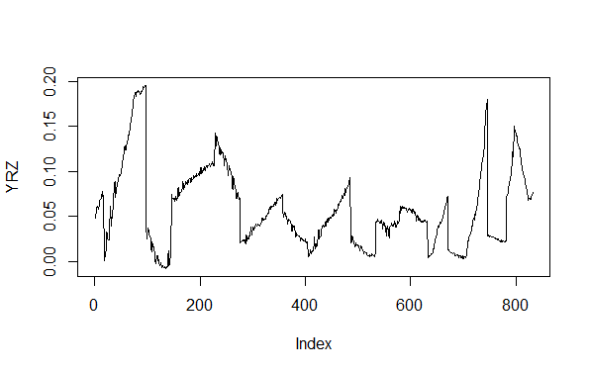
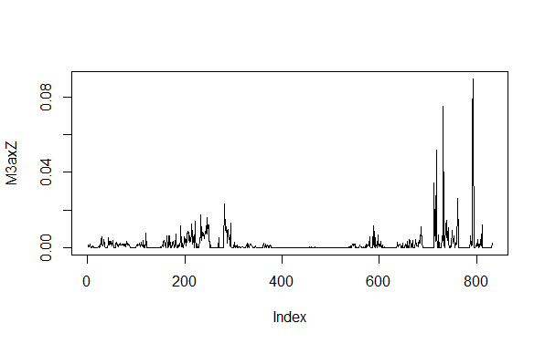
16-6-2015 12:04
25-6-2015 08:35

Slide 15
Co-cycle for Attractor set (M=100 <Nsmp)
cycle<-cycle+1
s<-1
# if every step takes a second then x*steps seconds ahead
Nstart<-Nsmp-M+1
U<-matrix(1,nrow=M,ncol=M)
n<-0
for (t in seq(Nstart,Nsmp)){
n<-n+1
#if(n>M){n<-n-M}
j<-0
for (i in seq(Nstart,Nsmp)){
j<-j+1
k<-j+s
if(k>M){
k<-k-M
}
g<-n+s
if(g>M){
g<-g-M
}
#product of matrix elm for composition law
U[n,j]<-phi[g,j]/(phi[n,k]*phi[s,j])
}
"first step mean=0.695188437993939"
"first step stdv=27.7614399381865"
"second step mean=-0.0361122879420189"
"second step stdv=0.00847138192269686"
"third step mean=1"
"third step stdv=0.234584469870708"
"Mean U = 1"
"Std dev U = 0.24"
================================================
"avg perc expl = 13.9135284858407"
"max perc expl = 25.9973169635653“
Uvar<-array(U,M*M)
sigmaU<-sqrt(var(Uvar))
meanU<-mean(U)
phi<-phi*mean(U)-sigmaU

Slide 16
iter<-0
Niter<-1000
chi<-matrix(0,nrow=M,ncol=M)
nRandomOmegaSpectrUpNW<-array(0,c(Niter,M,M))
nselSaveUpNW<-array(0,Niter)
pExpl<-array(0,Niter)
while(iter<Niter){
iter<-iter+1
r<-seq(1,M)
for (n in seq(1,M)){
samp<-sample(r,M)
for (i1 in seq(1,M)){
j<-samp[i1]
chi[n,i1]<-phi[n,j]
nRandomOmegaSpectrUpNW[iter,n,i1]<-j
}
}
xu<-Nsmp+1
xl<-Nsmp+M
cr<-array(-1,M)
Nbegin<-Nsmp-M+1
chi1<-chi*Y[Nsmp]
#chi1<-chi*mean(Y[Nstart:xl])
for(n in seq(2,M)){
cr[n]<-cor(chi1[,n],Y[xu:xl])
}
mxCr<-max(cr)
mxCr
for (n in seq(1,M)){
blCr<-(cr[n]==mxCr)
if(blCr==TRUE){
nsel<-n
}
}
nselSaveUpNW[iter]<-nsel
percExpl<-(mxCr^2)*100
pExpl[iter]<-percExpl
}
Sampling points(M=100) < Nsmp
Random “omega” indices phi.
Prediction points(M=100) > Nsmp

Slide 17
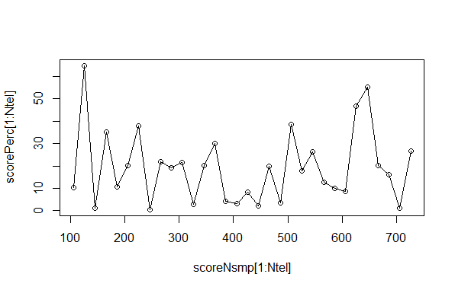
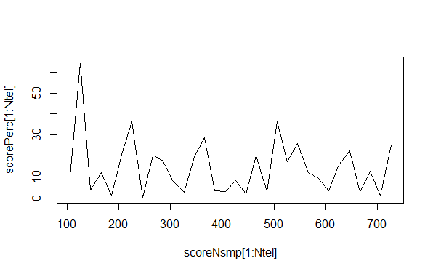
Sampling van random verstoringen in M=100 punten voor Nsmp om M=100
punten na Nsmp te kunnen voorspellen.
Mean tan = 0.9129398, step up/down ~ 18.2 % expl var
Band based on random generated data… < 15%

Slide 18
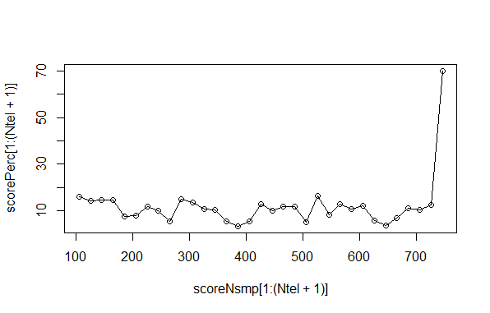
Random data (plus random temperature) & max perc expl.
reference

Slide 19
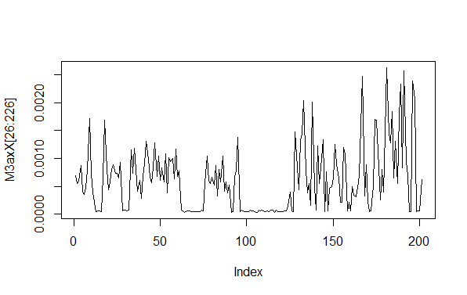
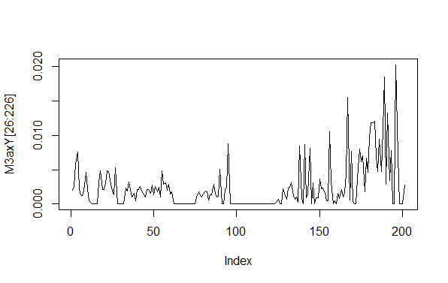
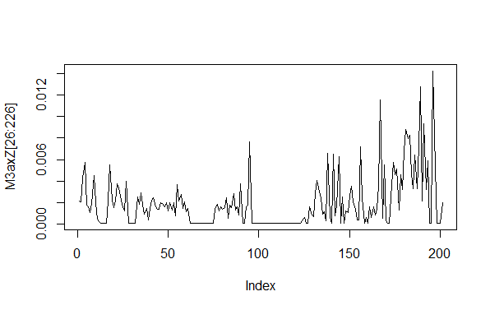
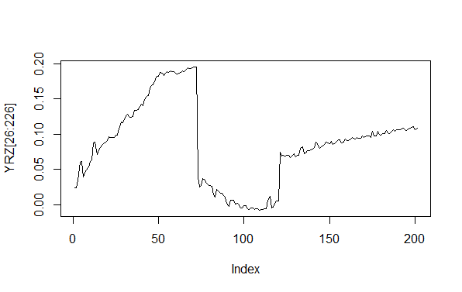
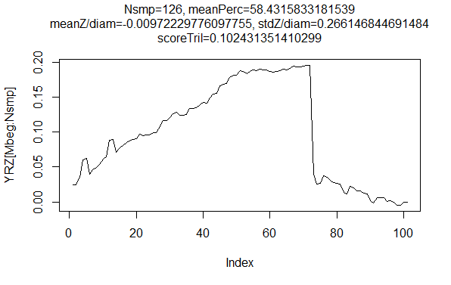

Slide 20
Invariant measure (Arch. Math. 75,(2000), 472-480, J. Lond. Math Soc. 63 (2001), 413-427.):
and
Least square type approximation for invariant measure. Assumed to hold reasonably well for (a small time-frame in) the “future” . We suppose third order polynomial.
Ideally,
Sum square,

Slide 21
Diagonal:
M=100 deformation <Nsmp

Slide 22
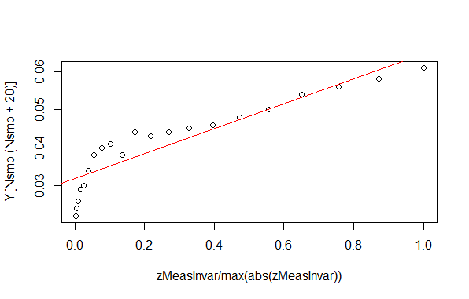
Meting M=20 (> Nsmp)
Def meting M=100 <Nsmp
zOmega<-array(0,M)
#j=t indices
for(j in seq(1,M)){
gamma1<-alpha[j]
gamma0<-beta[j]
fct<-1e4
D<-gamma1^2 - 4*(gamma0-(yOmega[j]*fct))
print(D)
if(D<0){
zOmega[j]<-0
}else{
zOmega[j]<--gamma1/2+(1/2)*sqrt(D)
}
}
as.function(muInvar<-splinefun(M3axT[Mbeg:(Nsmp-1)],zOmega))
Nsmp=646

Slide 23
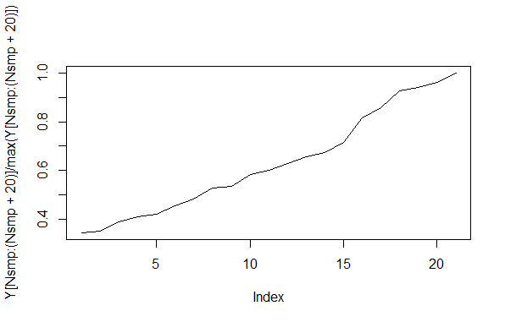
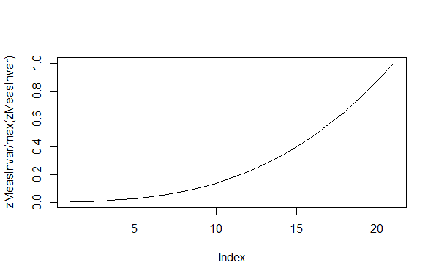
Prediction attempt:
(normalized)
Measured value
Nsmp=726
Points 727---746
(normalized)
Projected invariant
measure polynome.
Spline interpolated
function on time.
Points 727---746
as.function(muInvar<-splinefun(M3axT[Mbeg:(Nsmp-1)],zOmega))

Slide 24
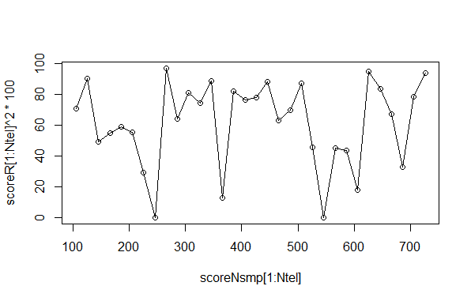
while(iter<Niter){
iter<-iter+1
r<-seq(1,M)
for (n in seq(1,M)){
samp<-sample(r,M)
for (i1 in seq(1,M)){
j<-samp[i1]
chi[n,i1]<-phi[n,j]
nRandomOmegaSpectrUpNW[iter,n,i1]<-j
}
}
xu<-Nsmp+1
xl<-Nsmp+M
cr<-array(-1,M)
Nbegin<-Nsmp-M+1
chi1<-chi*Y[Nsmp]
#chi1<-chi*mean(Y[Nstart:xl])
for(n in seq(2,M)){
cr[n]<-cor(chi1[,n],Y[xu:xl])
}
1
2
3
4
5

Slide 25
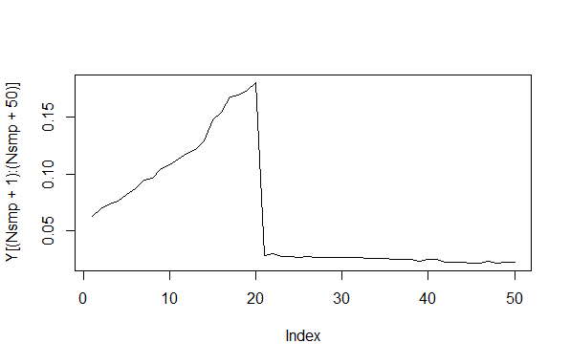
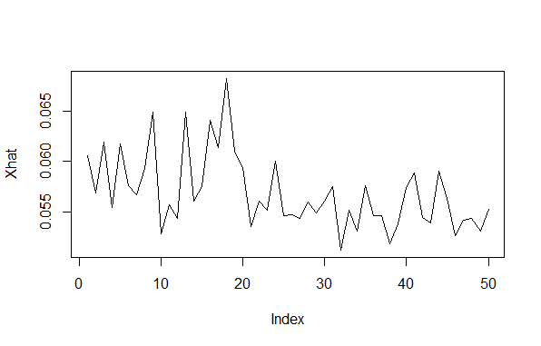
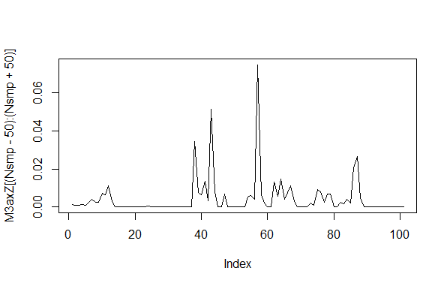
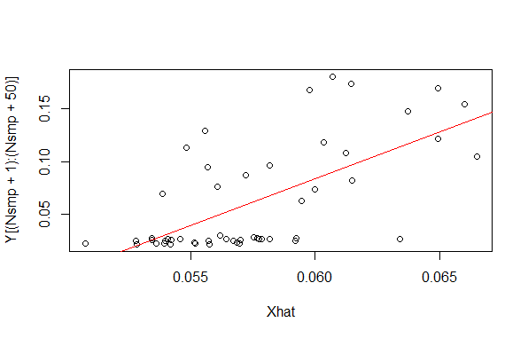
Cocycle prediction:
Nsmp=726
Cor= 0.6465466 (% = 41.80)
M1<-as.integer(M/2)
phiTrans<-array(0,c(M,M1))
Xhat<-array(0,M1)
Xtest<-Y[Nsmp]
for (n1 in (seq(M1,M))){
for (n2 in seq(1,M1)){
for( j in seq(1,M1)){
phiTrans[n1+n2-100,j]<-phi[n1,j+n2]*phi[n2,j]
}
}
}
blDoor<-TRUE
while(blDoor){
r<-seq(1,M1)
samp<-sample(r,M1)
for (j in seq(1,50)){
j1<-samp[j]
Xhat[j]=phiTrans[j,j1]*Xtest
}
#plot(Xhat,type="l")
cr<-cor(Xhat,Y[(Nsmp+1):(Nsmp+50)])
if (cr^2*100>39){
plot(Xhat,type="l")
blDoor<-FALSE
print(cr^2*100)
print(cr)
}
}

Slide 26
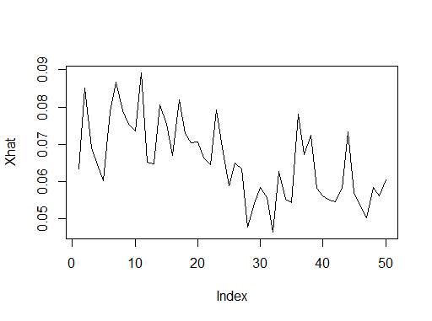
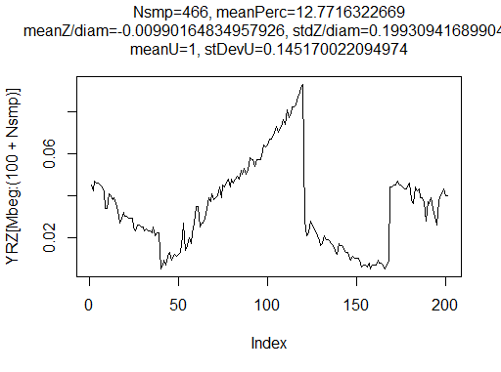
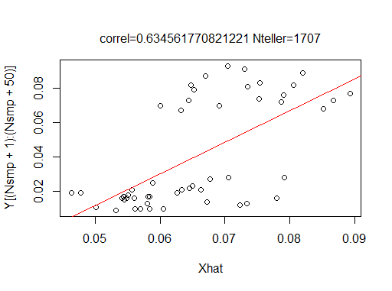

Slide 27
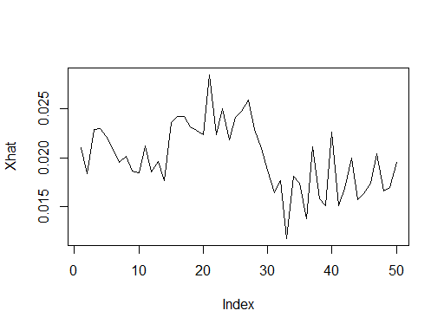
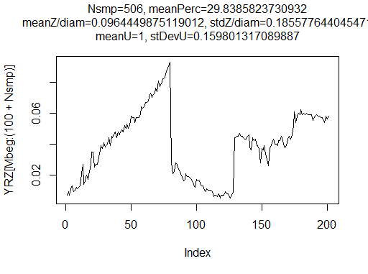
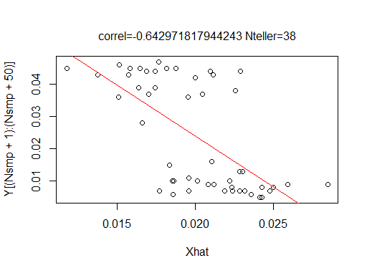

Slide 28
Samenvattend:
De methode maakt gebruik van statistische relaties waarbij de relatie
deformatie – trilling, zuiver als een kanstheoretisch probleem wordt opgevat.
Drie voorspellingsmethoden uit de RDS.
  Projectie:
    richting correlatie is positief,
    wisselend % verklaarde variantie (>15 % random)
  Invariante maat:
    geen richting informatie,
    hoge % verklaarde variantie (~ 70 %)
    wisselend
  Cocylische eigenschap:
    geen richting informatie,
    gemiddeld hoge % verklaarde variantie ( ~ 40%)
    constant
Notes:
De methode maakt gebruik van statistische relaties waarbij de relatie deformatie – trilling, zuiver als een statistisch probleem wordt opgevat.

Slide 29
Planning:
Nieuwe test data zoeken
  Deelname aan veld-experimenten
Andere objecten bestuderen met mogelijk andere sensoren
Samenwerking met partijen die geinteresseerd zijn de relatie
tussen schade en structurele akoestiek
  verzekeraars (Lloyds )
  instituten voor technisch natuurwetenschappelijk onderzoek
  KNMI

Slide 30
Dank voor uw aandacht.

Slide 32
add slides

Slide 33
First “time” derivatives:
and

Slide 34
M3axT time array
16-6-2015 12:04
25-6-2015 08:35

Slide 35
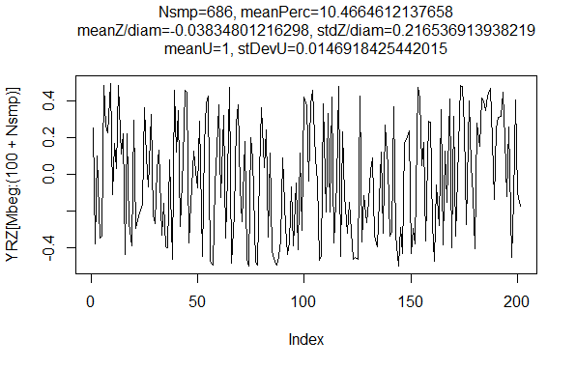

Slide 36
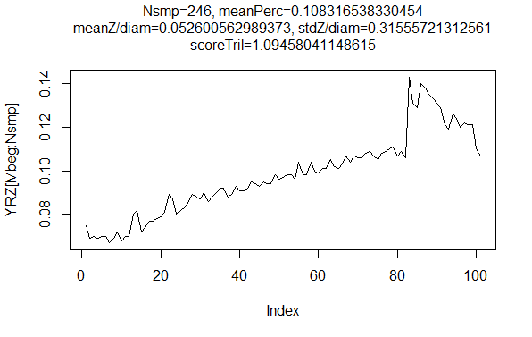
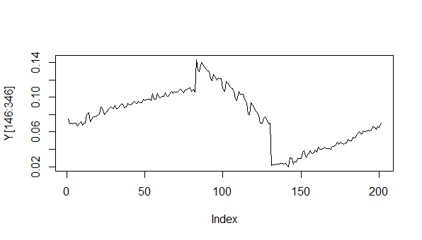
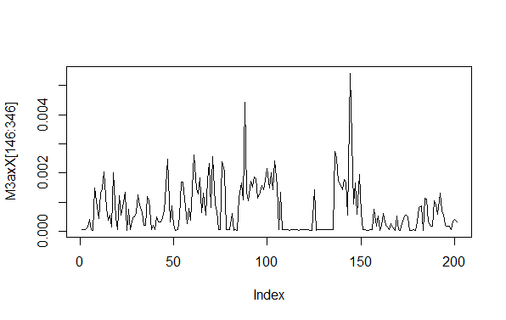
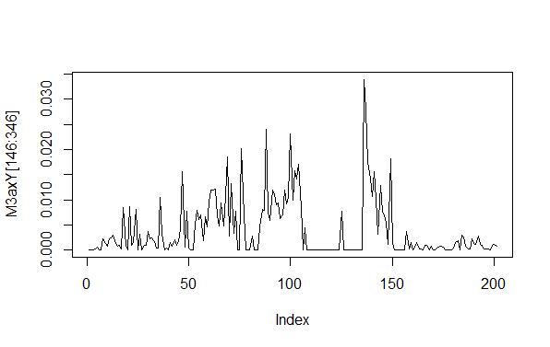


Slide 37
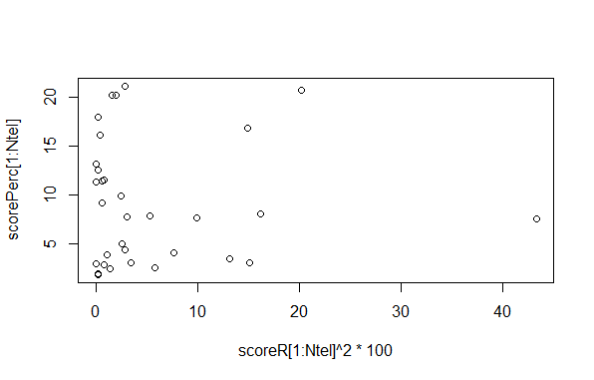
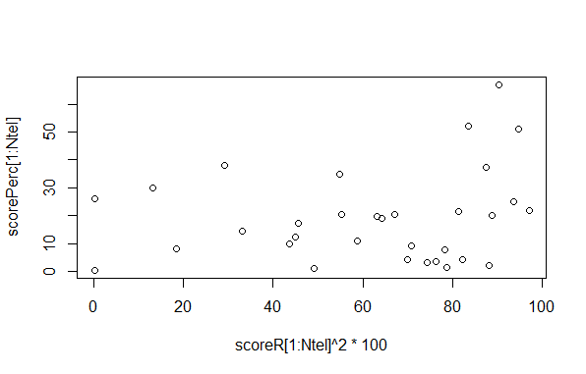
scoreR ^2 <- cor(zMeasInvar,Y[Nsmp:(Nsmp+20)])^2 #correlation spline interpoltd inv meas / Y
Random data
Real data

Slide 38
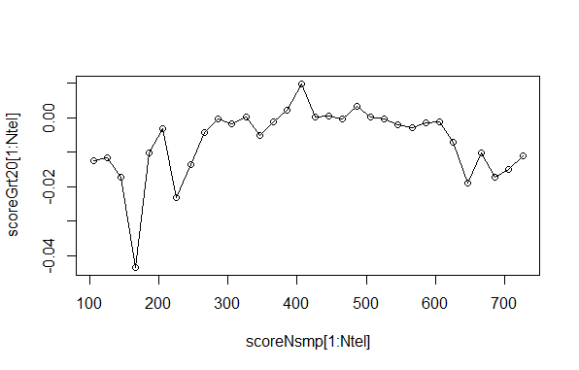
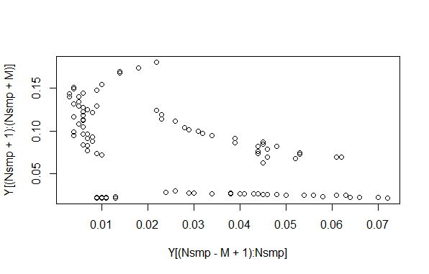
Correlation for Omega Z between M=100 before Nsmp
with M=100 after Nsmp.
Correlation Y for Nsmp=726, M=100
Cor(past def,future def)= -0.4880838

Slide 39
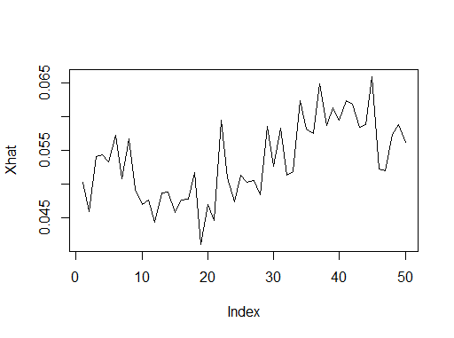
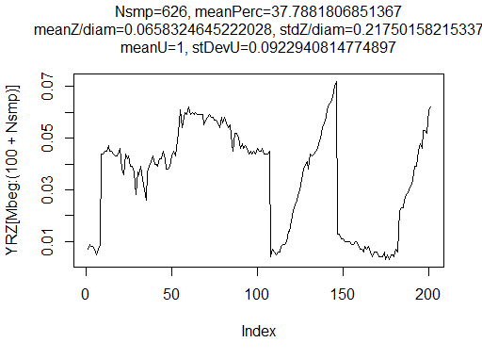
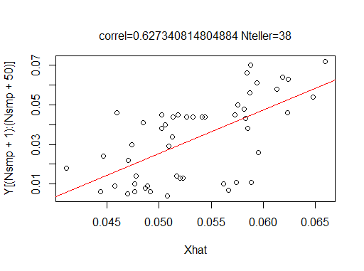

Slide 40
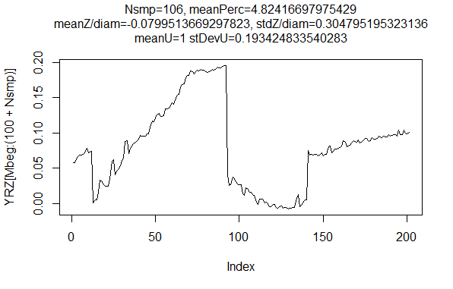

Slide 41
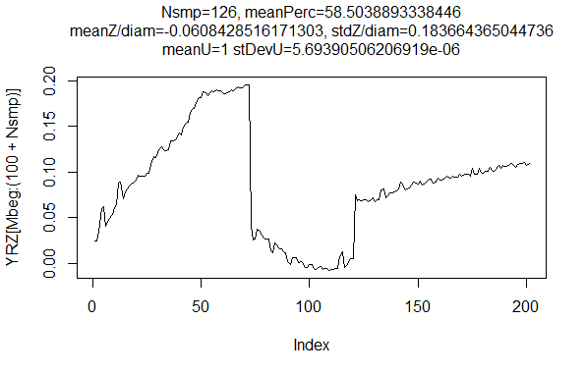

Slide 42
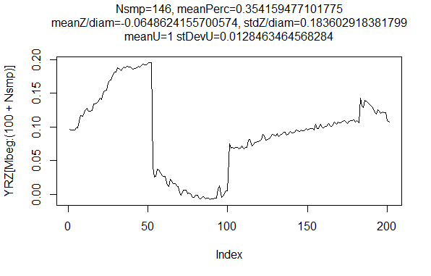

Slide 43
